Slide 1
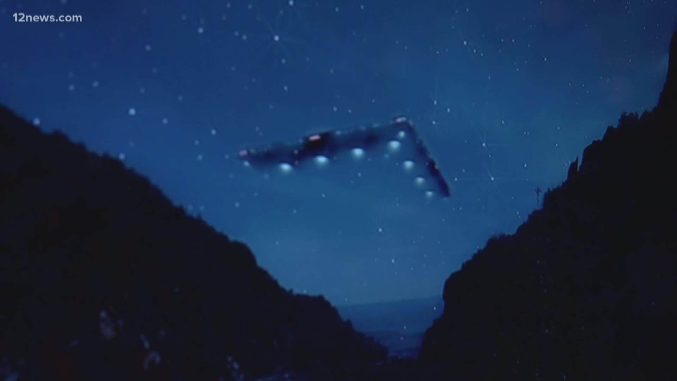
UFO Sightings in Arizona
Group 1 Final Project

Slide 2
Team Members
Connie Aceves
Angelica Rosario
Jordan Peterson
Katie Bernstein

Slide 3
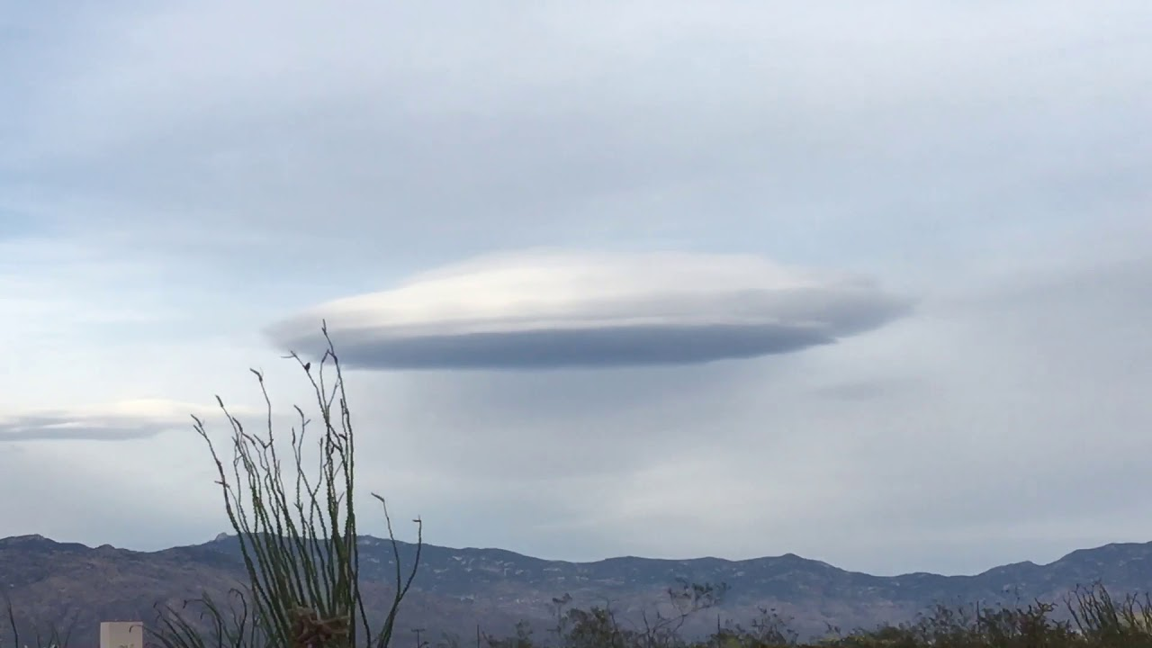
UFO Sightings in Arizona
Arizona has the 7th highest number of UFO sightings in the USA.
UFO sightings are a huge draw to tourism in Arizona and we wanted to use a data science approach to find out more about where these sightings might occur in the future.
As residents of Arizona, we are interested in where the sightings occur and how they might be influenced by the population increase in Arizona over the last 20 years.
There are UFO Conferences held in Arizona because of the high rate of sightings and interest.

Slide 4
UFO Sightings Dataset
Dataset Souce: Kaggle
https://www.kaggle.com/datasets/sadeghjalalian/ufo-sightings-in-usa
Data pulled from the National UFO Reporting Center (NUFORC)
This dataset contains the report content from the report itself including the time, location duration, and other attributes in both the raw form as it is recorded on the NUFORC site as well as a refined, standardized form that also contains lat/lon coordinates.

Slide 5
Additional Data Sources
City and Population Data Source: US Census Bureau: https://data.census.gov/cedsci/
World Population Review
https://worldpopulationreview.com/
United States Census data was utilized to determine proper city naming conventions along with gathering population data for each year of the project scope (2000 to 2022) to allow us to analyze the growth of the cities in relationship to the number of sightings in each city.

Slide 6
Project Questions:
Do UFO sightings in Arizona increase at the same rate as the city’s population growth in the state of Arizona?

Slide 7
Technology Used:
Dataset ETL/ERD:
Python and Jupyter Notebook
Machine Learning Model:
Google Colab – PySpark
Pandas
SKLearn Cluster
Plotly
Matplotlib
HV Plot
Database Creation
PGAdmin: Creating tables and joining tables
SQL Alchemy: Connection String to Python
QuickDBA: ERD Creation
Data Visualization
Power BI

Slide 8
Exploratory Data Analysis (ERD) - Connie

Slide 9
Machine Learning Model – Angelica

Slide 10
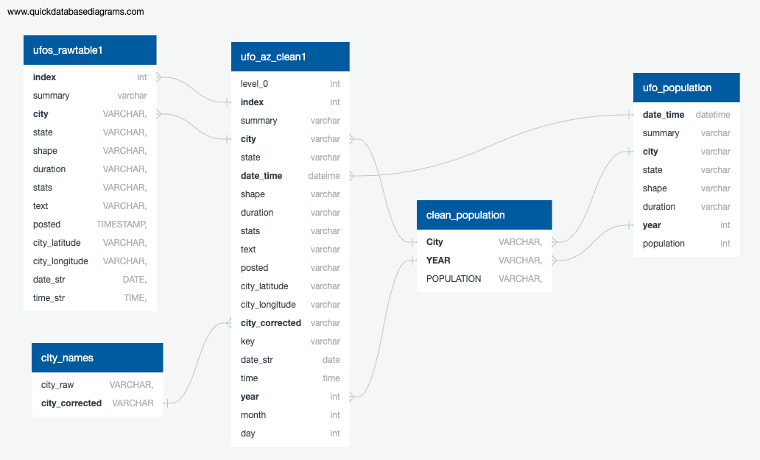
SQL Database Creation - Katie

Slide 11
Data Visualization - Jordan

Slide 12
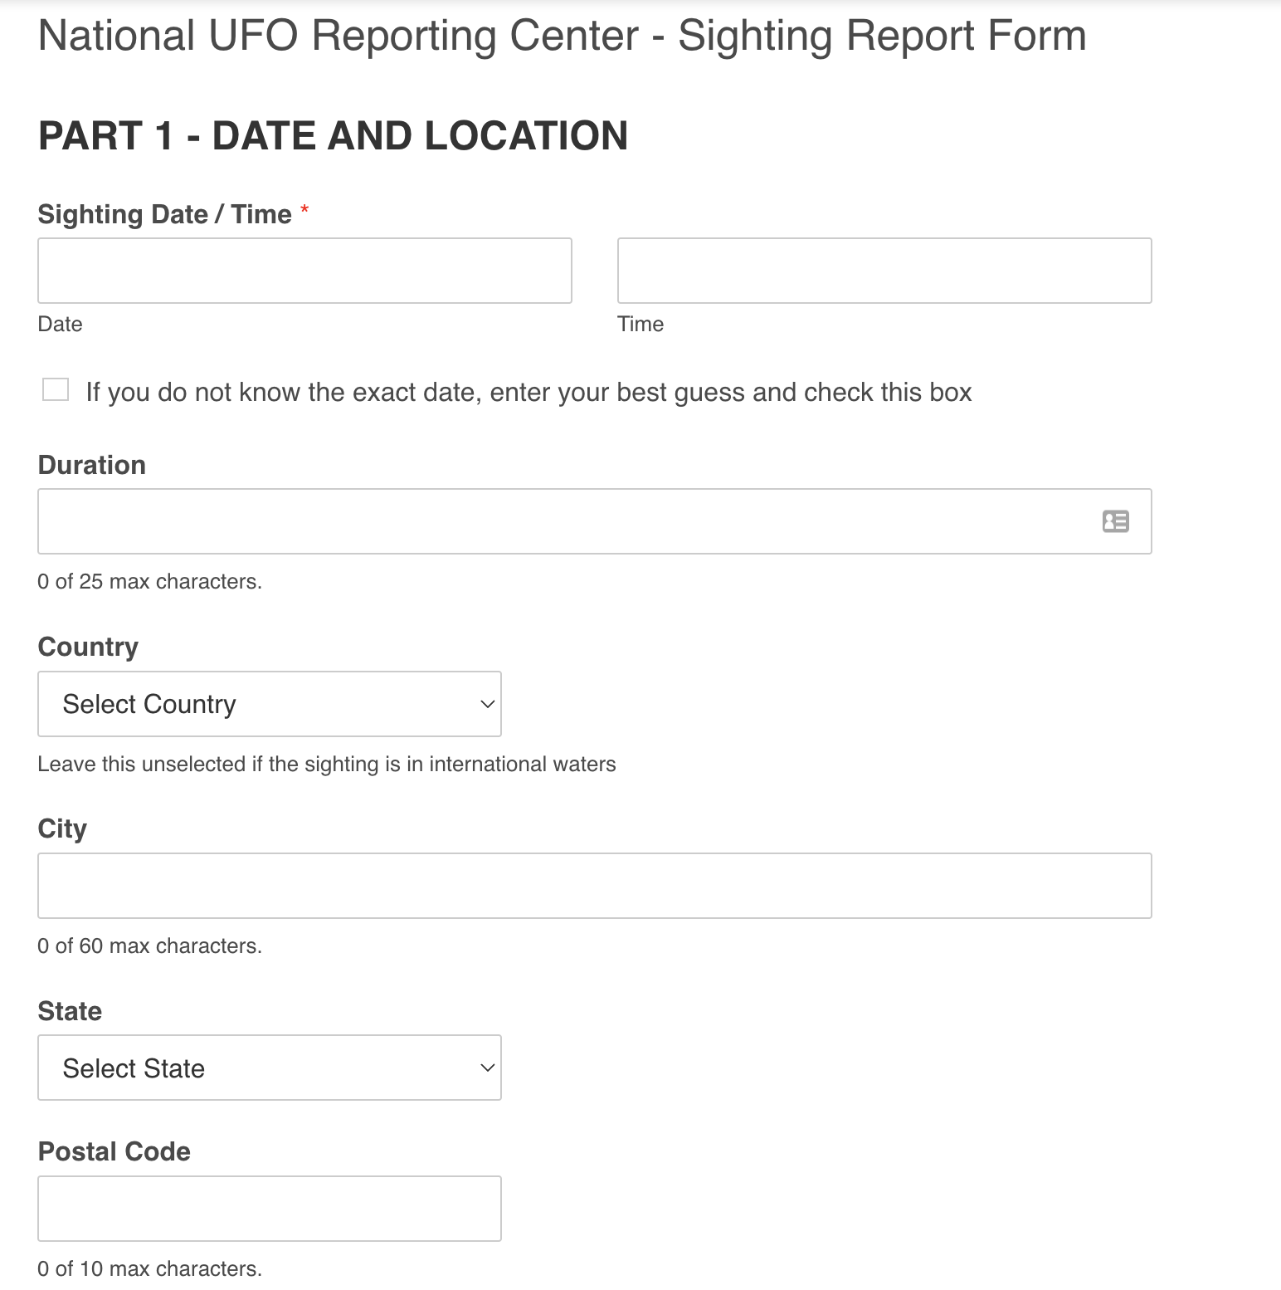
Recommendations for Future Analysis
National UFO Reporting Center Recommendations:
Less free form answers – more drop down options to reduce the amount of non-sense data or variability in the data.
Sighting Validation – new column or area of data where NUFORC can add their feedback that either approves or denies the sightings. Currently it is listed in the comment box.
Additional Datasets to include:
Weather Patterns
Locations of Government Testing Sites, Military Bases and other business locations that might effect the data.

Slide 13
Project Debrief – Lessons Learned
Select a dataset that has less free form data to help with the machine learning models.

